Slide 1
Committee Chairs
Transitioning Leadership

Slide 2
Plan of Work
Complete
Procedures, process
Tracking
Timeline
Outcomes

Slide 3
Recommendations
Based upon successes, challenges
New ideas generated from experience
Regulations, procedures that need changing
Alerts, warnings that may arise

Slide 4
Self Evaluation
Committee needs to assess its value to the association

Slide 5
Committee
Where has the committee been most effective? What was the committee’s greatest contributions?
Where is the committee least effective?
What are the strengths?
What challenges?

Slide 6
Committee, continued
What additional information and training would help committee members be more effective and informed?
Is this committee needed for future work, boards?

Slide 7
Transition
Have you:
Checked all information that needs to go forward
Communicated what is important
Assured a legacy of leadership
Measured your investment
Decided to continue serving

Slide 8
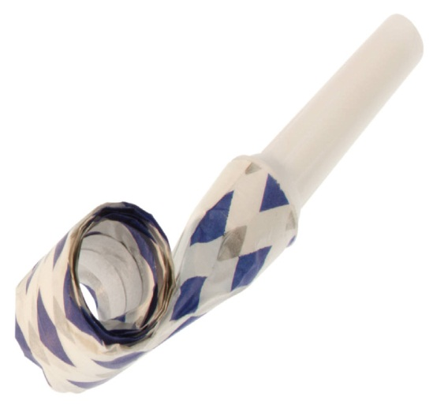
Thank you We Celebrate You
Investment
Commitment
Service
Dedication
____________________
Deb Fritz, NSR
National PTA
dfritz@pta.org – 571-329-9345

